Slide 1


CSB4301 - WEB TECHNOLOGY
B.Tech – V Semester
Dr. Muthukumaran M
School of Computing Sciences,
Department of Computer Science and Engineering

Slide 2
Lecture 9-Transitions and Positioning
CSS Transitions
CSS transitions allows you to change property values smoothly, over a given duration.
How to Use CSS Transitions?
To create a transition effect, you must specify two things:
the CSS property you want to add an effect to the duration of the effect
Note: If the duration part is not specified, the transition will have no effect, because the default value is 0.

Slide 3
Transitions and Positioning
The following example shows a 100px * 100px red <div> element. The <div> element has also specified a transition effect for the width property, with a duration of 2 seconds:
div { width: 100px; height: 100px; background: red; transition: width 2s; }

Slide 4
Transitions, and Positioning
<!DOCTYPE html>
<html> <head>
<style>
div {
width: 100px;
height: 100px;
background: red;
transition: width 2s;
}
div:hover {
width: 300px; }
</style>
</head>

Slide 5
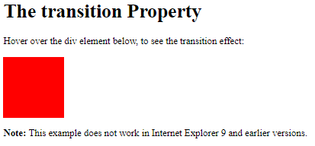
Transitions, and Positioning
<body>
<h1>The transition Property</h1>
<p>Hover over the div element below, to see the transition effect:</p>
<div></div>
<p><b>Note:</b> This example does not work in Internet Explorer 9 and earlier versions.</p>
</body>
</html>

Slide 6
Transitions, and Positioning
Change Several Property Values
The following example adds a transition effect for both the width and height property, with a duration of 2 seconds for the width and 4 seconds for the height:
div { transition: width 2s, height 4s; }

Slide 7
Transition + Transformation
The following example adds a transition effect to the transformation:
div { transition: width 2s, height 2s, transform 2s; }

Slide 8
The position Property
The position property specifies the type of positioning method used for an element.
There are five different position values:
static
relative
fixed
absolute
sticky
Elements are then positioned using the top, bottom, left, and right properties. However, these properties will not work unless the position property is set first. They also work differently depending on the position value.

Slide 9
The position Property
position: static;
HTML elements are positioned static by default.
Static positioned elements are not affected by the top, bottom, left, and right properties.
An element with position: static; is not positioned in any special way; it is always positioned according to the normal flow of the page:
This <div> element has position: static;
Here is the CSS that is used:

Slide 10
The position Property
<h2>position: static;</h2>
<p>An element with position: static; is not positioned in any special way; it is
always positioned according to the normal flow of the page:</p>
<div class="static">
This div element has position: static;
</div> </body>
<!DOCTYPE html>
<html>
<head>
<style>
div.static {
position: static;
border: 3px solid #73AD21;
}
</style>
</head>
<body>
</html>

Slide 11
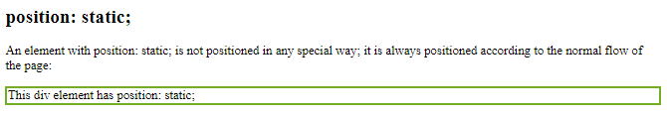

Slide 12
The position Property
position: relative;
An element with position: relative; is positioned relative to its normal position.
Setting the top, right, bottom, and left properties of a relatively-positioned element will cause it to be adjusted away from its normal position. Other content will not be adjusted to fit into any gap left by the element.
This <div> element has position: relative;
Here is the CSS that is used:

Slide 13
The position Property
position: relative;
Example
div.relative { position: relative; left: 30px; border: 3px solid #73AD21; }

Slide 14
The position Property
position: fixed;
An element with position: fixed; is positioned relative to the viewport, which means it always stays in the same place even if the page is scrolled. The top, right, bottom, and left properties are used to position the element.
A fixed element does not leave a gap in the page where it would normally have been located.

Slide 15
The position Property
Notice the fixed element in the lower-right corner of the page. Here is the CSS that is used:
Example
div.fixed { position: fixed; bottom: 0; right: 0; width: 300px; border: 3px solid #73AD21; }

Slide 16
The position Property
position: absolute;
An element with position: absolute; is positioned relative to the nearest positioned ancestor (instead of positioned relative to the viewport, like fixed).
However; if an absolute positioned element has no positioned ancestors, it uses the document body, and moves along with page scrolling.
Note: A "positioned" element is one whose position is anything except static.
Here is a simple example:

Slide 17
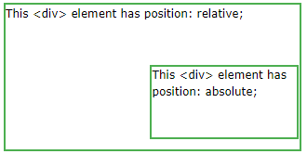
The position Property
div.relative { position: relative; width: 400px; height: 200px; border: 3px solid #73AD21; } div.absolute { position: absolute; top: 80px; right: 0; width: 200px; height: 100px; border: 3px solid #73AD21; }

Slide 18
The position Property
Overlapping Elements
When elements are positioned, they can overlap other elements.
The z-index property specifies the stack order of an element (which element should be placed in front of, or behind, the others).
An element can have a positive or negative stack order:
img { position: absolute; left: 0px; top: 0px; z-index: -1; }

Slide 19
ACTIVITY :
Insert an image and position text over an image at various positions such as “top left”, “top right”, “bottom left”, “bottom right”, “centre”.

